Slide 1
OS Security
(Chapter 15)

Slide 2
Outline
Security Problem
Security Violation Categories
Security Violation Methods
Program and network threats
Security techniques
Cryptography: a security tool

Slide 3
The Security Problem
OS security refers to specified steps or measures used to protect the OS and to make the system secure
  System secure if resources used and accessed as intended under all circumstances
Intruders (crackers) attempt to breach security
Threat is potential security violation
Attack is attempt to breach security
Attack can be accidental or malicious
Easier to protect against accidental than malicious misuse

Slide 4
Security Violation Categories
Breach of confidentiality
  Unauthorized reading of data
Breach of integrity
  Unauthorized modification of data
Breach of availability
  Unauthorized destruction of data
Theft of service
  Unauthorized use of resources
Denial of service (DOS)
  Prevention of legitimate use

Slide 5
Security Violation Methods
Masquerading (breach authentication)
  Pretending to be an authorized user to escalate privileges
Replay attack
  Data transmission is maliciously repeated
Man-in-the-middle attack
  Intruder sits in data flow, masquerading as sender to receiver and vice versa
Session hijacking
  Intercept an already-established session to bypass authentication

Slide 6

Standard Security Attacks

Slide 7
Security Measure Levels
Impossible to have absolute security, but make sufficiently high cost to deter most intruders
Security must occur at four levels to be effective:
  Physical
    Data centers, servers, connected terminals
  Human
    Avoid social engineering, phishing,
  Operating System
    Protection mechanisms, debugging
  Network
    Intercepted communications, interruption, DOS

Slide 8
Program Threats
Many variations, many names
Trojan Horse
  malware which misleads users of its true intent
  Spyware, pop-up browser windows
Trap Door
  Software bug or undocumented feature left intentionally by the programmer
    Can be used later to get access to the system
  Could be included in a compiler
  Difficult to detect

Slide 9
Program Threats (Cont.)
Logic Bomb
  Program that initiates a security incident under certain circumstances
Viruses
  Code fragment embedded in legitimate program
  Self-replicating, designed to infect other computers
  Many types
    File
    Boot
    Macro
    Source code
    Polymorphic
    Encrypted

Slide 10
Network Threats
Network threats involve the abuse of network services and connection
  Worm: a program that can replicate itself and send copies from computer to computer across network connections.
  Port Scanning: aim at detecting system vulnerabilities to launch an attack
  Denial of service: aim at disturbing the legitimate use of system services

Slide 11
Security Techniques
Authentication
  process of verifying an identity claimed by a system entity
Methods
  Password based authentication
  Token based authentication
  Biometric authentication

Slide 12
Security Techniques …
Access Control
  dictates what types of access are permitted, under what circumstances, and by whom
    Discretionary Access Control
    Role-based access control
Intrusion Detection
  finding attempts to an unauthorized access to system resources
    Host-based Intrusion detection
    Network based intrusion detection

Slide 13
Security Techniques …
Virus Protection
  Antivirus approach: use antivirus to protect the system
  Antivirus works in following steps
    Detect
    Identify
    removal

Slide 14
Cryptography as a Security Tool
Constructing and analyzing protocols that prevent third parties or the public from reading private messages
  Source and destination of messages on network cannot be trusted without cryptography
a sender can encode its message so that only a computer with a certain key can decode the message
enables a recipient of a message to verify that the message was created by whom

Slide 15
Encryption
Encryption algorithm consists of
  Set K of keys
  Set M of Messages
  Set C of ciphertexts (encrypted messages)
  A function E : K → (M→C). That is, for each k ∈ K, E_{k} is a function for generating ciphertexts from messages
  A function D : K → (C → M). That is, for each k ∈ K, D_{k} is a function for generating messages from ciphertexts

Slide 16
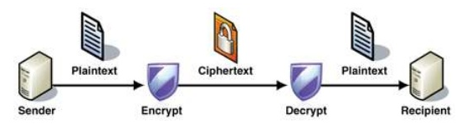
Encryption (Cont.)

Slide 17
Symmetric Encryption
Same key used to encrypt and decrypt
  Therefore k must be kept secret
DES was most commonly used symmetric block-encryption algorithm (created by US Govt)
  Encrypts a block of data at a time
  Keys too short so now considered insecure

Slide 18

Secure Communication over Insecure Medium

Slide 19
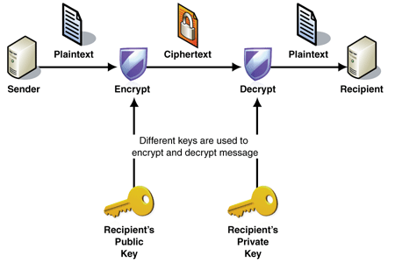
Asymmetric Encryption
Public-key encryption based on each user having two keys:
  public key – published key used to encrypt data
  private key – key known only to individual user used to decrypt data

Slide 20
End Chapter 15

